Slide 1
Sandeep Arora ca, cma, cs, chfi, cissp, ccsp, cisa CyberImmersions Forensics Solutions (CIFS) A niche solutions provider - forensic audit and digital forensics lab. & services CyberImmersions.com
Forensic Audit - Approach, Methodology, Tools & Emerging areas
“Well, as through this I’ve rambled
I’ve seen lots of funny men,
Some rob you with a gun
Some with a fountain pen”

Slide 2
Agenda
Fraud Types and Case studies
Forensic Audit
What is Forensic Audit?
Financial Audit & Forensic Audit
Role & Need of Forensic Audit
Forensic Audit Methodology
Tools & techniques
Digital Forensics in Forensic Audits
Emerging technologies challenges and benefits in Forensics audit

Slide 3
Frauds: A Primer

Slide 4
Frauds Type – select list
Many types of frauds broadly categorized into the following types:
Insolvency & Bankruptcy Fraud –Transactions which pertain to preferential, undervalue, defrauding creditors, wrongful or fraudulent trading
Corruption
Asset Misappropriation
Financial Statement Fraud
Money Laundering
Securities Fraud
Theft of Intellectual Property
Insurance Fraud
Real Estate Fraud
Health Care Fraud
Cyber Fraud

Slide 5
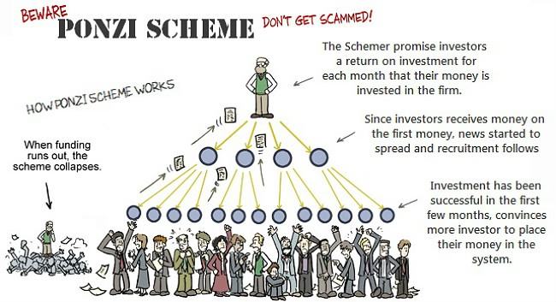
Types of Frauds – Ponzi Schemes
Now a days – it gets bundled with emerging tech. areas like Cryptocurrencies

Slide 6
Case Study – PNB Bank Fraud
Rs. 11,394 Crores

Slide 7
Case Study – PNB Bank Fraud
Discovery
Representative of accused companies approach Mumbai branch to request buyers’ credit
No pre-arranged credit limit – branch official directed company to give full amount as collateral against LoU (fresh)
Representative insisted LoUs raised in the past without collateral
PNB did not find record of such transactions in its databases
Found: junior employees issued fraudulent LoUs over SWIFT interbank messaging system
No LoUs logged on core banking system
Key Failure Points
No rotation of duties
Non Integration between SWIFT & Core banking System
Management Failure
Internal Auditor

Slide 8
Case Study – Satyam (Dec 2008)
Satyam Background - Revenue: $2.1 Billion Listed on NYSE, DOW
How it happened? - Creative Accounting, Financial Statements Manipulation, Bribery
Overstated Revenue (Fake billings) & Profits
Overstated cash & bank balances, debtors
Non-existent accrued interest
Understated liability
Paid Salaries to non-existent employees - 40,000 (actual) vs. 53,000 (books)
Key Failure Points
Management planned fraud at CEO (Ramalingam Raju), CFO level
Role of internal auditors and Involvement of external auditors from PwC
Board governance issues
SEBI clean chit on corporate governance law

Slide 9
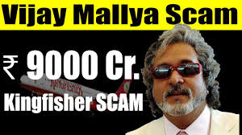
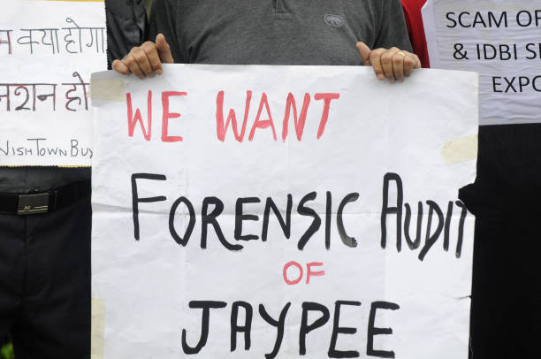
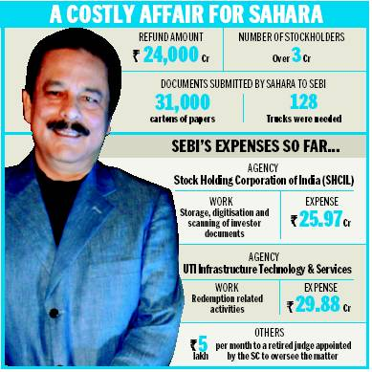
Other Frauds - examples

Slide 10
Forensic Audit

Slide 11
What is Forensic Audit?
Forensic – “Belonging to, used in or suitable to courts of judicature or to public discussion and debate”
‘Forensic Audit’ is generally taken to refer to a comprehensive view of fraud investigation, including
Business Methodology
Forensic Accounting - The audit of accounting records and systems to prove or disprove fraud
Digital Forensics
Investigation
Litigation Support

Slide 12
Difference Between Financial & Forensic Audits
Issue | Financial Audits | Forensic Audits
Frequency | Recurring | Incidental & Nonrecurring
Objective | Compliance Advisory & Control | Culpability & Liability Investigation, Compliance
Scope | Generic & Broad – Random Sampling; Fair View | Specific Data Set; Exact & Precise
Relationship with Client | Non-adversarial | Adversarial
Methodology & Process | Accounting Standards | Accounting Standards, IT standards, Industry-Specific Standards
Presumption | Professional Skepticism | Evidence-based

Slide 13
Forensic Audit – Need & role
CBI/SFIO/NIA/EOW/CVC/ED/EIC etc.
Regulators/SEBI/RBI
Insolvency Professionals
Operations & Mismanagement
Mergers & Acquisitions
Holding & Subsidiary Companies
Conventional Accounting – only compliance requirements
Litigation Support
Proactive
Mandated Audit
Regulatory Compliance
Diagnostic Tool – Prevent Fraud
Reactive
Investigate Fraud Suspicions
Gather Evidence
Litigation Support
Investigation of Allegations

Slide 14
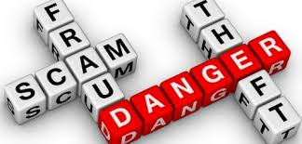
Forensic Audit – key challenges
Law enforcement agencies investigators lack key skills (different than conventional crimes) – forensics accounting, digital forensics
Lack of blended skills talent pool
Limited awareness on the best approach to follow – fraud unknown, value, how it was done, who all are involved, how to approach
Evidence may have been deleted
Limited time
High use of technology in committing frauds
Identification and admissibility of the digital evidence
Limited availability of digital forensics lab in private sector

Slide 15
Forensic Audit methodology
Identify Problem & Scope
Analysis, Investigation & Collect Evidence
Legal Action
Reporting
Phase 1
Phase 2
Phase 3
Phase 4

Slide 16
Phase 1 Forensic Audit – identification and scope

Slide 17
Forensic Audit - Identification & Scope
Identification of Problem
High level assessment – red flags (prima facie)
Client communication
Define Objective and Scope
Coverage & objective of audit
Important for preserving integrity of evidence including legal requirements
Key phase – will impact subsequent phases depth and tools & techniques
Resource Mobilization – internal and external (engaging experts)
Key stakeholders mapping

Slide 18
Phase 2 Forensic Audit – Analysis, Investigation & evidence collection

Slide 19
Forensic Audit: analysis and Investigation
Preliminary Assessment
Vetting key concerns
Record key contacts for liaison & resource requirements
Collate known issues and theories
Narrow areas of concern
Business areas, processes
Time periods, transactions, persons, locations, accounts, etc.
Detailed scrutiny of documentation
Interviews with witnesses and other relevant parties

Slide 20
Forensic Audit: Investigation
Approach – Investigation Strategy
Transition from general information or overview to specific transactions/period/ information/People
Fraud Theory Approach
Analyze information
Create theory or possible scenarios
Evaluate theory or scenario
Review and amend

Slide 21
Fraud Theory Approach
Develop Theory
Evidence
Evaluate Theory
Who might be the culprit?
What happened?
Why allegations might be true?
What methods were used?
When did the fraud happen?
How did the fraud happen?
Where is the evidence?
In the accounts?
Off-books?
Direct or circumstantial?
Potential witnesses
Does theory fit evidence?
Revise & Amend
Is evidence sufficient?

Slide 22
Forensic Audit: Analysis and Investigation
Conduct the investigation – questions to ask and answer:
Credibility of concerns
Suspects and their relationship with the client organization
Time of fraud/discrepancies
How did it occur?
What transactions were involved?
What business objectives/activities were involved?
Level of employees involved? – managers, directors, officers, clerks etc.
Who has information? Who might be a witness?
Third party involvement – benefits, kickbacks, bribes etc.
Who were the third parties & how were they involved?
Record in financial statements – tampering, falsification, misappropriation
Internal audit findings

Slide 23
Forensic Audit – Evidence Gathering
Analyzing Documentation
Interview Process
Digital Forensics
Data Analysis & Mining
Emerging Technologies

Slide 24
Forensic Audit– document Analysis & accounting
Analyzing Documents & Accounting
Internal Audit Reports
Transaction Databases
Financial Statements
Vouchers, Invoices, Receipts
Forgeries – docs & signatures
Erased & eradicated documents
Accounting & Industry Standards
Regulatory Guidelines
Can make or break case
Obtain:
Original documents
All relevant documents
Criteria for assessment:
Relevance
Materiality
Authenticity

Slide 25
Forensic Audit - interviewing
Interview
Obtain information from witnesses, victims, suspects
Question-answer format – neutral to friendly demeanor
Types of interviews
On the Scene – unplanned & real-time basis
Formal – planned with objective approach
Interview Techniques
Assessment of body language + physical tics to indicate lies
Cognitive Interview: based on memory triggers to glean accurate facts on events
Note-taking & Recording
Maintaining Eye Contact
Don’t broadcast own opinions or emotions – remain neutral
Document results

Slide 26
Forensic Audit - interviewing
Important things to notice and consider
Body language – frustration, nervousness, evaluating, suspicion/secrecy, defensiveness
Aggressive behavior & Attitude
Discrepancies & Contradictions
Comments, Excuses, Forgetfulness, Denials
Legal Considerations
Authority to conduct interviews – legal risks for company; employee rights
Use of deception – might attract personal liability
False Imprisonment – might be claimed by the interviewee if forced to remain in room
Recording interviews
Privacy of interviewees

Slide 27
Forensic Audit – data analysis and mining
Data Analysis & Data Mining
Data analysis – statistical operations to analyze data and derive conclusions
Data mining – searching through large amounts of data to identify patterns
Outcome – detect red flags indicating problem areas
Data analysis done using Computer Assisted Audit Techniques (CAATs)
Questions data analytics can help forensic auditors answer:
 | Past | Present | Future
Information | What happened? (Reporting) | What is happening now? (Alerts) | What will happen? (Extrapolation)
Insight | How and why did it happen? (Modelling, Experimental Design) | What’s the next best action? (Recommendations) | What’s the best/worst that can happen? (Prediction, Optimization, Simulation)

Slide 28
Forensic Audit – data analysis and mining
Big Data
Means – high volume velocity, variety of information
Difficult to process, need specialized tools and expertise
Structured Data v. Unstructured Data
Structured – in database, recognizable organization or structure
Records, payments, financial reports
Unstructured – not in database or spreadsheet
Emails, invoices, social media activities, documents
Data Mining
Development of response methods – anti-fraud methods
Determine fraud targets & evaluate against fraud theory
Fraud indicators or red flags – transactions, patterns, relationships etc.
Data matching

Slide 29
Forensic Audit – data analysis and mining
Selective list of functions performed by CAATs:
Sorting & Indexing
Record Selection
Equations
Pivot Tables
Stratification
Joining
Multi-File Processing
Correlation & Regression Analysis
Compliance Verification
Duplication Search
Fuzzy Logic Matching
Gap Tests
Benford’s Law Analysis
Graphing

Slide 30
CAATs’ Process
Import
Multiple Heterogeneous Sources: Different Databases, Data Warehouses, Data Marts
Extract, Transform, Load (Preprocessing for Data Quality)
Data Cleaning (remove noise and inconsistent data)
Data Integration (multiple data sources)
Data Selection (data relevant to the analysis)
Transformation (consolidated into forms appropriate for mining by performing summary or aggregation operations)
Data Analysis
Export or Report
Identify Data Sets
Import
Reconciliation
CAAT Functions
Review

Slide 31
CAAT – Tools (Select list)
ACL (Audit Command Language)
ACL Analytics is a PC client-based data extraction and analysis software tool used for fraud detection & prevention, and risk management.
IDEA (Interactive Data Extraction and Analysis)
Generalized audit software program
Excel
ActiveData for Excel
It was designed to overcome Excel’s many limitations
AutoAudit
Comprehensive, integrated audit automation system
Of particular interest to fraud examiners are its risk assessment functions

Slide 32
Data analysis and mining – Tools (Select list)
SSDT (SQL Server Data Tools)
IBM Cognos
IBM SPSS Modeler
SAS Data Miner
Data Warehouse tools
Business Objects
Rapid Miner
Tools deployment vary depending on nature, source, variety, format of the data and objective of the analysis

Slide 33
Why Digital Forensics is inevitable today?
Pervasive integration of technology in business operations
ERPs, E-commerce, Cloud storage, Social Media, digital signatures, online banking
Most frauds have extensive use of technology including Mobile, Social media, Instant messenger
Data varieties – structured and unstructured
Deleted data or damaged devices/systems
Acquire & Preserve Data, which can be proven in the court as evidence
Electronic evidence indispensable part of forensic audit - admissibility is the key
Emerging technologies
Digital Forensics is not an option….must to do

Slide 34
Case Study - Enron
Enron, the 7th largest U.S. company in 2001, filed for bankruptcy in Dec 2001
How it happened?
Overstated Revenue & Profits
Manipulated Future Cashflows
Incorrect Reporting to SEC
Created SPE (Special purpose entities) to divert debts and used funds, did not show in the books
Conflict of Interest with Auditors (Arthur Anderson)
Senior management involved (Chairman, CEO, CFO)
Investigation & Mining for Evidence:
Skills Used: Digital Forensics & Forensic Audits
Documents shredded by auditors and others within company
The sheer scope of the Enron case, believed to be the largest computer forensics case in history (2001), dwarfs other financial probes. Investigators will pore through 10,000 computer backup tapes, 20 million sheets of paper and more than 400 computers and handheld devices

Slide 35
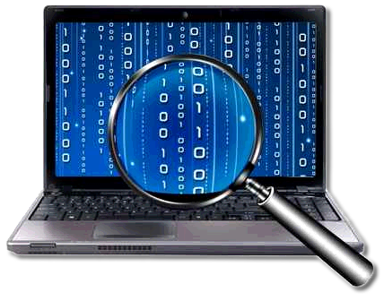
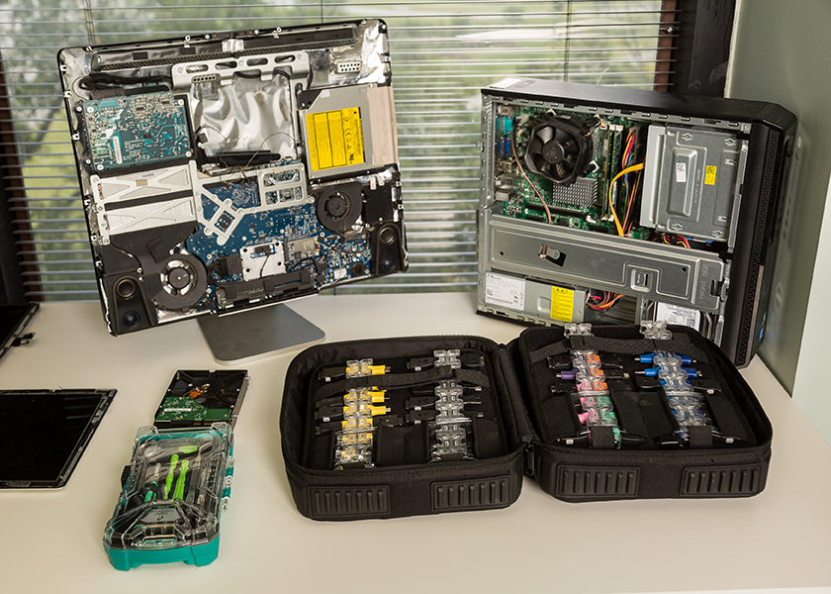
Digital Forensics landscape
Digital Forensics
Disk Forensics
Mobile Forensics
Email Forensics
Network Forensics
Crypto Forensics
Audio/Video Forensics
Diverse, complex & continuous evolving

Slide 36
Digital Forensics - Process
Seizure & Preservation
Acquisition & Recovery
Preliminary Analysis
Investigation
Conclusion & Reporting

Slide 37
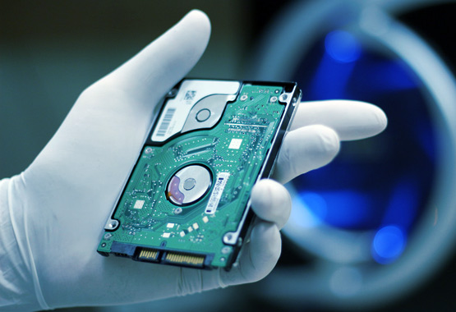
Digital Forensics – Process
Seizure & Preservation:
Capture data – digital devices, cloud, logs
Official or Law Enforcement: Police seizures
Private Investigation: Cooperation, Private Investigation Agencies
Maintain state of original evidence - integrity
Acquisition & Recovery:
Where data deleted or tampered with
Collect digital artifacts – files, folders, metadata, transactions, applications, emails
Internet history & emails
Tools - examples
Disk (EnCase, FTK, Magnet, X-Ways, etc.)
Mobile (UFED, Oxygen, XRY, Mobileedit, etc.)
E-discovery (NUIX, etc.)
Password recovery tools

Slide 38
Digital Forensics - Process
Preliminary Analysis
Examine artifacts based on specific requirements – based on fraud theory and red flags
E.g.: Analysis of HDDs, Email headers, PDF headers, email tracing
Recognition and analysis of deleted, missing or encrypted data
Investigation
Based on findings in preliminary analysis
Detailed scrutiny of digital artifacts
Entails data analytics & data mining in addition to standard digital forensics tools
Integral aspect of forensic audit process – investigation & gathering evidence
Host Evidence - memory, network connections, processes, open ports, disks, file systems, external devices, data, logs
Network Evidence – data packets, IP addresses, ports, logs
Conclusion & Reporting

Slide 39
Digital Forensics - Challenges
Evidence - Unintentional Issues
Quality of evidence deteriorates quickly – issues with preservation
E.g. Volatile memory, temporary files etc.
Human error – user, investigator
E.g. lack of resources, lack of storage space, negligence
Analysts Issues
Shortage of time
Skills – expertise sorely lacking, lack of vision
Hire outsiders or outsource
Needs blended skills – forensics, legal and finance
Tool-dependent – too much reliance on tools, lack of analytical abilities

Slide 40
Digital Forensics - Challenges
Tool Issues
Restrictions and Bugs – limited functionalities, inaccuracy
Vulnerabilities – tampering with evidence, investigation, compromising forensics machine system
Data Issues
Encryption – inaccessibility of information
Proprietary Formats – inaccessibility/permissions, compilation issues, incompatibility with tools
Strategies employed by suspects/perpetrators
Data destruction or manipulation – challenges in recovery & acquisition
Data Hiding – obfuscation, fuzzy logic, steganography
Anti-Forensics - methods to undermine data quality & quantity
Emerging technologies – Lack of forensics tools

Slide 41
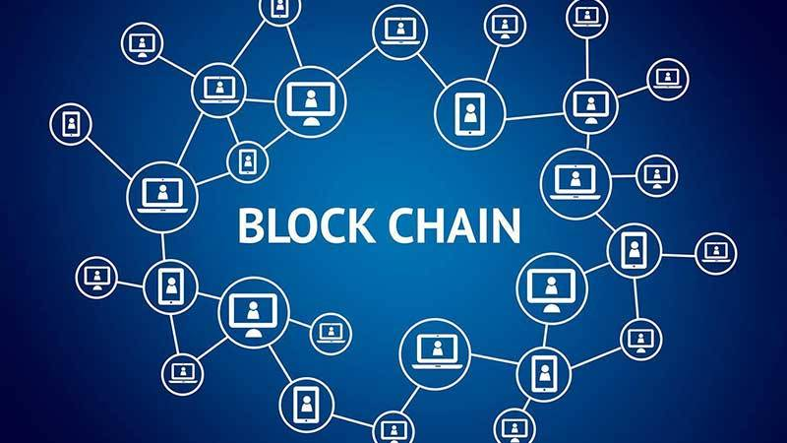
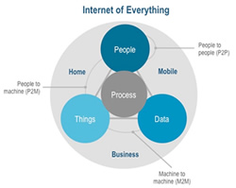
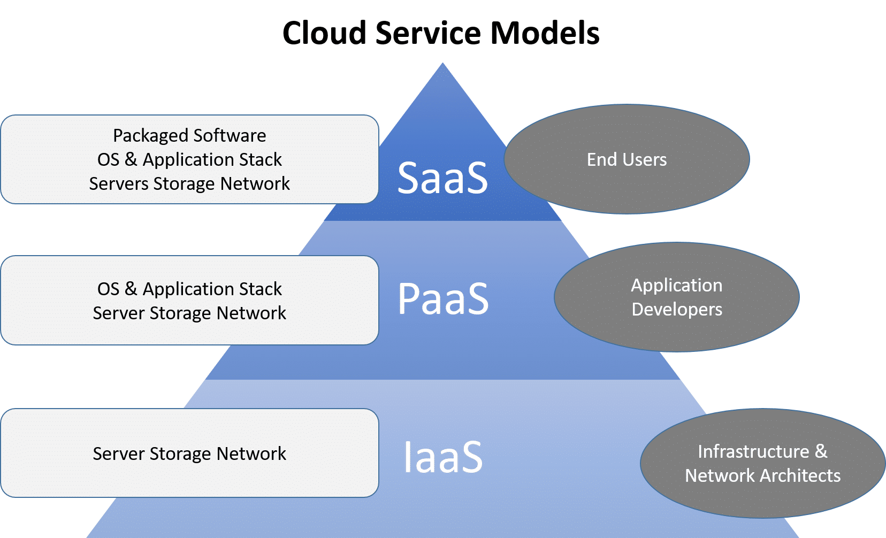
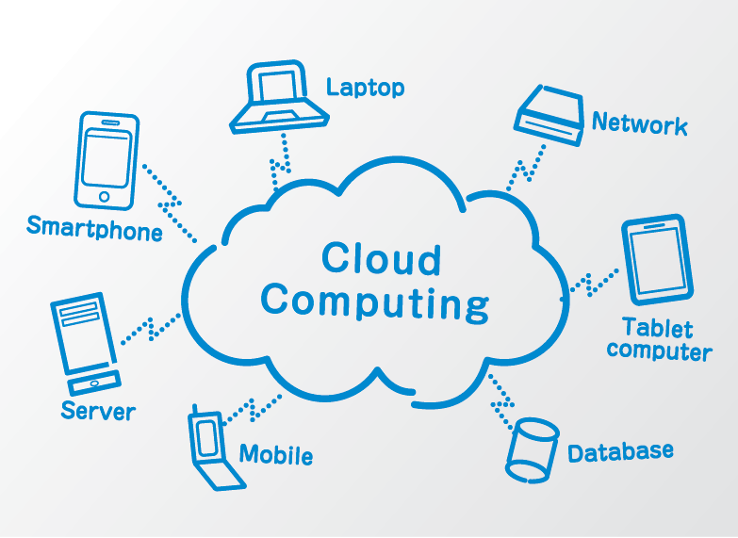
Emerging technologies – Challenges & Benefits for forensic audit
Blockchain
Cloud
Machine Learning
Artificial Intelligence
Internet-of things

Slide 42
Phase 3 Forensic audit - reporting

Slide 43
Forensic Audit - Reporting
Objective
Facts and evidence, logical presentation - clear link to facilitate informed decision-making
Conclusive and decisive – not ambiguous
Good Report Characteristics
Depending on the scope/objective, relevant legal dimensions (admissibility, evidence, expert witness) shall be taken into account in the report
Areas to avoid in an forensic audit report
Speculation, Subjective statements, Statements like “It appears”, “It’s interesting to note”
Conclusions - not well supported

Slide 44
Forensic Audit - Reporting
Forensic Audit Report : Sample Format Structure
Further, Digital Forensic report specifically need to capture:
Chain of custody - Evidence acquisition, preservation and integrity
Software licenses and specific hardware used
Forensics experts skill sets

Slide 45
Phase 4 Forensic audit – legal action

Slide 46
Forensic Audit – Legal Action
Client course of action dependent on outcome of forensic audit/report
Advisory role of auditor
Key options:
Criminal Proceeding – lodge FIR or file a complaint to initiate criminal investigation
Regulatory Action – complaints or regulatory action within industry e.g. SEBI, RBI, ED, SFIO, CVC, NCLT
Recovery of Amounts
Settlement – in case of civil frauds or with the direction of regulatory bodies
Litigation – depending on nature of the case, litigation may be required and relevant court/other judicial mechanism
Legal Action
FIR
Regulatory Action
Recovery of Amounts
Settlement
Expert Witness or Testimony by Forensic Auditor, where applicable

Slide 47
Forensic Audit - Legal Action
Key acts linked with Forensic audits but not limited to
Prevention of Money Laundering Act, 2002
Prevention of Corruption Act, 1988
Companies Act, 2013
Insurance Act, 1938
Insolvency and Bankruptcy code, 2016
Foreign Exchange Management Act, 1999
Regulators guidelines – RBI, SEBI, etc.
IT Act, 2000 and related guidelines
The code of Criminal procedure, 1973
Civil Procedure Code 1908

Slide 48
Forensic Auditing as a Profession
Finance & Audit
Legal
IT & Digital Forensics
Business
methods
Blended skills is MUST
Growing area in demand - excellent rewards
Expert witness
Specialized tools and techniques including digital forensic lab. experts
Dynamically changing led by technology and new regulations

Slide 49
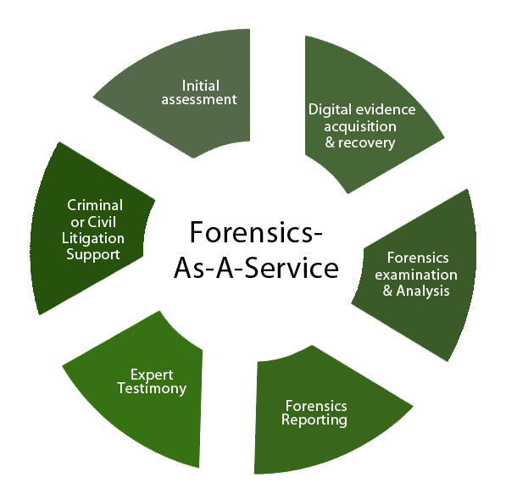
CyberImmersions – What we do?
Forensic Audit & Forensics As A Service
(In-house Digital Forensic Lab.)
Data Privacy
GDPR & Personal Data Protection Bill
Training & Workshops
Privacy policy and other policy design
Readiness Assessment
Privacy Impact Assessment
Privacy framework design
Implementation advisory
Cyber Law Advisory / Compliance
Techno-Legal Domain
Drafting Agreements & Policies
IT Act and other cyber law compliance
Emerging tech. legal risks assess &
compliance - startups/ due diligence/M &A
Litigation Support
Inline digital evidence admissibility in the court

Slide 50
For any queries, you may write to cyberimmersion.com, an online platform owned by CyberImmersions Forensics Solutions (CIFS) for Forensic Audits and Digital Forensics
Sandeep Arora
Co-founder & CEO
CyberImmersions Forensics Solutions
Cyberimmersions.com
Email - Sandeeparora@cyberimmersions.com
Mobile - +91 9860628921
CyberImmersions Forensics Solutions (CIFS) is a training, education and consulting solutions provider with focus in digital forensics, litigation support, and forensic audit areas. We have the right services, expertise and solutions to help you in your transformation journey irrespective of your profession, business type, domain and size.
Forensics-As-A-Service | Digital Forensics | Disk Forensics | Mobile Forensics | Email Forensics | Payment Card Forensics | Forensic Audits

Slide 51
This presentation is owned by Cyberimmersions Forensics Solutions Pvt. Ltd. (CIFS) and is protected by Copyright Laws. Any unlicensed reproduction or distribution or use without prior permission of the owner is strictly prohibited. Cyberimmersions Forensic Solutions Pvt. Ltd. (CIFS) reserves all rights and will pursue legal action against any copyright infringements.

Slide 52
Case Study - Sahara
SEBI v. Sahara India Real Estate Ltd.
Started when a CA based in Indore sent notice to National Housing Bank
Request bank to inspect housing bonds issued by Sahara India Real Estate Corp. (SIREC) and Sahara Housing Investment Corp. (SHIC)
Found: Bonds issued to investors not per SEBI rules
National Housing Bank forwarded same to SEBI for investigation
Review of Draft Red Herring Prospectus (DRHP) – raise equity for another Sahara real estate company through IPO
Disclosed – SIREC and SHIC raising huge amounts through Optionally Fully Convertible Debenture from public
Allegations:
SEBI declared raising thousands of crores through OFCD illegal
Total dues payable – Rs. 40,000 with interest

Slide 53
Case Study - Sahara
What happened?
DRHP stated company was private limited but raised money from public
OFCD issued to more than 50 people in violation of statements in DRHP
Run as a public offer even though DRHP claimed it was for selective clients
Did not report the same to SEBI
Issued bonds to fake investors
Fake investors were Sahara creations
Allegations:
Money Laundering
Securities Fraud
Fictitious Assets

Slide 54
Ricoh India Limited
SEBI through order dated 16.08.2018 in the matter of Ricoh India Limited considering large-scale irregularities in the business transactions of the company and manipulations in its books of accounts amounting to fraud
SEBI confirmed the directions issued vide the ad interim ex-parte order dated February 12, 2018 read with order dated March 06, 2018
Further directed that Ricoh, its directors and the other parties to proceedings shall extend all necessary co-operation to the independent auditor/audit firm appointed by BSE for conducting the above-mentioned detailed forensic audit and shall furnish all information/documents sought from them from time to time
And extended the time for submission of the forensic audit report by the forensic auditor to SEBI through BSE till September 30, 2018

Slide 55
Forensic Audit Approach
Law & Standard
Risk Assessment & Investigation Analysis
Accounting / Audit
Business Method
Reporting & Proving
Systems / Technology

Slide 56
Forensic Audit - focus
Investigative analysis, inquiry, or inspection of
Documentation and ‘paper trail’
Electronic systems/data
People
Determine and discover
Fraud
Embezzlement or Siphoning of Funds
Asset misappropriation – hidden assets
Focus on economic transactions and reporting – evidentiary value

